Slide 1

Face Detection using Haar Cascade

Slide 2
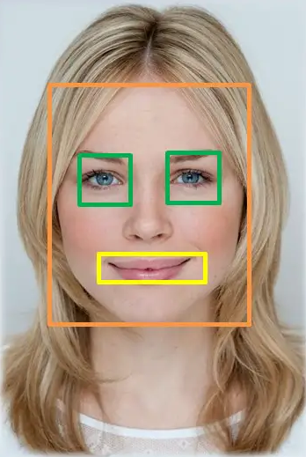
Haar cascades were first introduced in 2001, and it was one of the most popular object detection algorithms in OpenCV.
Identifying a custom object in an image is known as object detection. This task can be done using several techniques.
Haar cascade is an algorithm that can detect objects in images, irrespective of their scale in image and location.
This algorithm is not so complex and can run in real-time. We can train a Haar-cascade detector to detect various objects like cars, bikes, buildings, fruits, etc.
Haar cascade uses the cascading window, and it tries to compute features in every window and classify whether it could be an object.

Slide 3
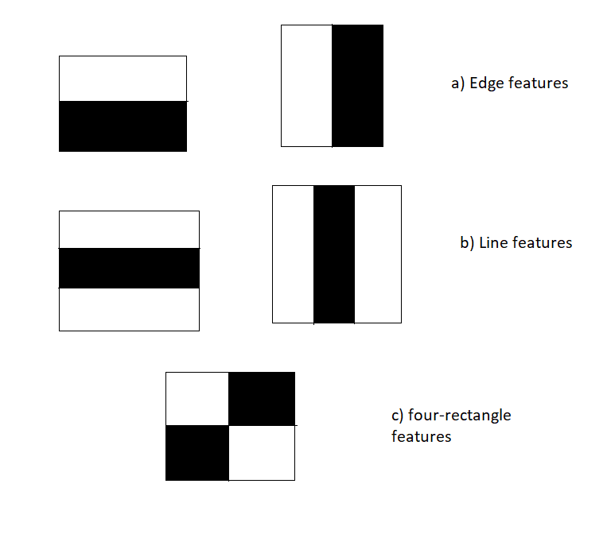
It does this by creating patterns with pixels next to each other, these patterns are either edge detection or line detection.
Edge Detection pattern is a series of white pixels above a series of black pixels or reverse, this pattern can be horizontal or vertical.
Line Detection pattern is series of black pixels sandwiched between series of white pixels or reserve i.e. white pixels sandwiched between black, this pattern can also be vertical or horizontal.

Slide 4
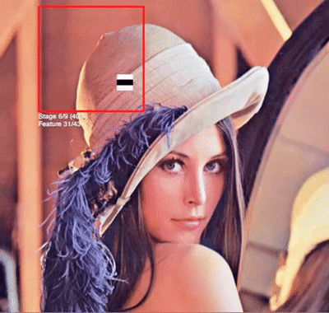
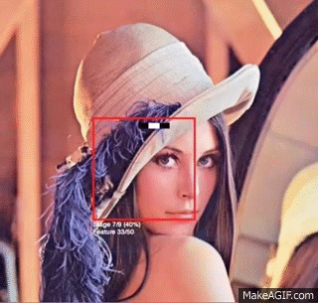
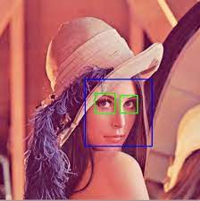
In order to identify all the features, the Haar Cascade Edge/Lines Feature runs over the image portion(the rectangle box), known as the detection window.
The detection process is repeated multiple times, again and again till all the features are captured. The whole image traversed using the detection window and Haar Cascade features.

Slide 5
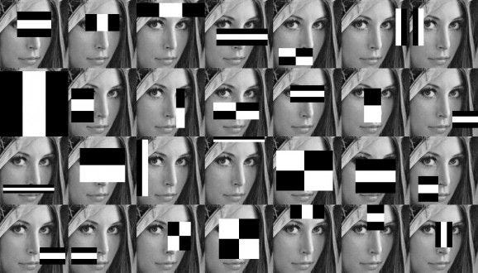
Gradually, it will cover more features of the face, using edge and line patterns, like eyebrow (edge pattern), lips (line pattern), nose (line pattern), eyes (edge pattern).

Slide 6
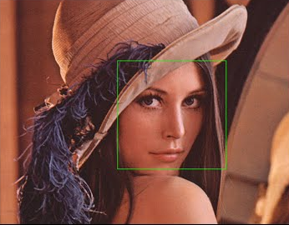
The classifier will keep running till it is able to identify the features and at the end it combines all the features and returns a rectangle output in the form of x, y the starting point from where face is detected, along with width & height.

Slide 7
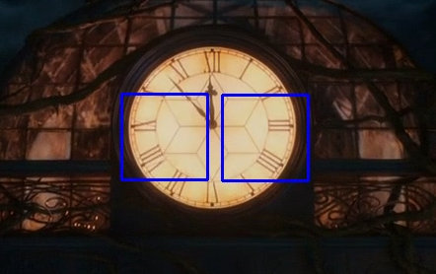
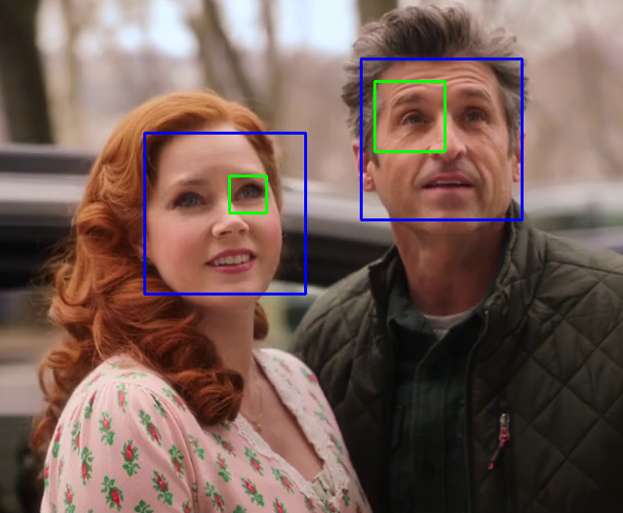
PROS
CONS
They are fast and can work well in real-time.
Simple to implement, less computing power required.
Pre-trained classifiers for
Human face detection
Eye detection
Nose / Mouth detection
Vehicle detection
It is not as accurate as modern object detection techniques are.
It runs on only grayscale images.
It has a downside. It predicts many false positives.

Slide 8

THE END

